Slide 1
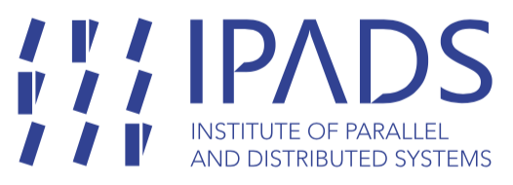

Introduction to System Security
SE3331-1 (2022 Fall)
IPADS, Shanghai Jiao Tong University
https://www.sjtu.edu.cn
Notes:
Credits to Mike Freedman (COS 461) and others.

Slide 2
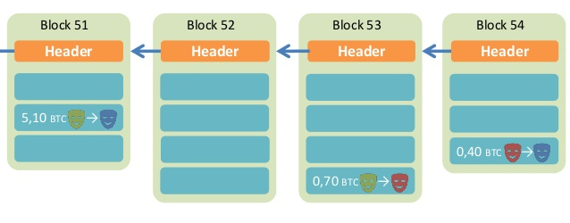
Review: BitCoin
PT:会记录用户的credit来记录用户的下载和上传的数据量，
避免一个用户只下载不上传的情况出现。
BitCoin is a decentralized public-accessable ledger
Using hashes as a pointers, which form a chain
Tamper-proof (assuming 51% honest)
Time

Slide 3
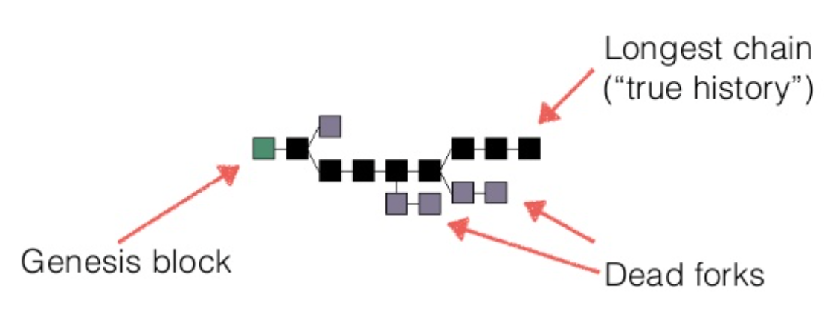
Trust the Majority
If a majority of CPU power is controlled by honest nodes, the honest chain will grow the fastest and outpace any competing chains
To modify a past block, an attacker would have to redo the proof-of-work of the block and all blocks after it and then catch up with and surpass the work of the honest nodes

Slide 4
Existing Solutions
Proof of Work (PoW)
Brute force to solve a random number (nonce)
Inefficient, waste of resources
Satisfy the number of first 0s
Tx data
Compute
the
hash
Output
Timestamp
Nonce
Nonce++
PreHash

Slide 5
Incentive
By convention, the first transaction in a block is a special transaction that starts a new coin owned by the creator of the block
The incentive can also be funded with transaction fees
The incentive may help encourage nodes to stay honest
If a greedy attacker is able to assemble more CPU power than all the honest nodes, he ought to find it more profitable to play by the rules than to undermine the system and the validity of his own wealth

Slide 6
Questions
在BTC中，造假是不可能的。因为会通过hash的方式进行加密，而验证一个hash是否符合条件是远远简单于求出一个hash是符合条件的。而如果造假，会很快被其他人发现从而拒绝这个TX，从而使得BTC算力下降，从而使个人利益受损。
1.Can some one other than the owner spend a coin?
2.What if I lose my private key?
3.Is it possible to have inflation?
4.Is mining really decentralized?
5.Is it necessary to use PoW? It's a waste of power!
6.How can I get bitcoin?
1.不会，因为在BTC中，需要使用个人的私钥进行一个TX，所以其他人不能使用自己的BTC。
2.如果丢失了私钥，那么就会直接失去所有的BTC。
3.不可能。因为btC总量是有上限的，并且丢失私钥之后会直接丢失财产，所以只会通货紧缩而不会通货膨胀。
4.不一定。因为有的寡头可能占有过高的算力比率。
5.POW只是为了让系统慢下来。但是确实会浪费过多资源。

Slide 7
Smart Contract
指的是一个node不光存储一个TX信息，还可以“写代码”。既可以自动地通过这段代码得到一个新的TX。这种代码是由所有矿工共同执行的。这种代码必须要是具有结果确定性的。
The nodes not only store transactions, but also code
... and also execute the code to gen new transaction!
The code is known as "smart contract"
Execution can be triggered by events/invocations

Slide 8
Larger Storage
Store general data, instead of only transaction
Then a node needs to prove it does store the data
Proof of retrievability(可获取性), in challenge-response form
Examples: IPFS, STORJ
一种验证一个数据是否还被存储的方式：
将数据随机分成几等分，每过相同时间就获取一个随机的hash，去要求存储数据的那台机器也去计算对应数据的hash，若每次都能对应的上，说明数据还在。但是这也并不能一定保证数据的完备性，因为hash计算还是有很小的概率会重复的。

Slide 9
Permissioned Chain
Bitcoin is a permission-less chain
Protect user's privacy by anonymity(匿名，只需要有私钥和公钥)
Also hard to track
Permissioned chain is not anonymous
E.g., several companies build a chain used by themselves only
It is just a multi-manager distributed database, which has nothing new

Slide 10
It's all about Trust
Why blockchain?
We need a consensus for a ledger
There is no third party to be trusted
If there is someone trusted by all, then blockchain is not needed
Blockchain is slow and hard to use
It is designed to be that way
Considering the storage and bandwidth of the ledger

Slide 11
Questions
Why BitCoin is so valuable?
A bit-string itself does not worth anything
It is the consensus that matters
A decentralized global consensus is hard to achieve
Before BitCoin, it is even thought as impossible
BitCoin solves this problem by incentive. Human is in the loop!
How to ban BitCoin?

Slide 12
Security Intro

Slide 13
Attacks Happen
Lots of personal info stolen
Attackers broke into server w/ ~800K records on Utah patients
Phishing attacks(钓鱼攻击)
Users at ORNL tricked by phishing email about benefits from HR
Millions of PCs are under control of an adversary
Which is called "Botnet(肉机)"
Stuxnet
Infected Iran's uranium processing facilities
Fake certificate

Slide 14
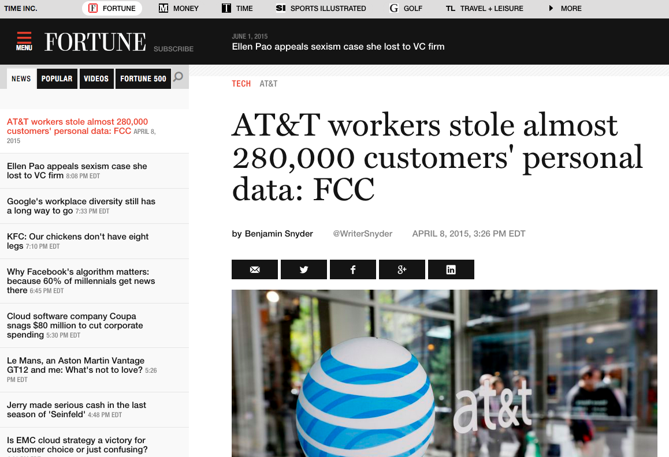

Slide 15
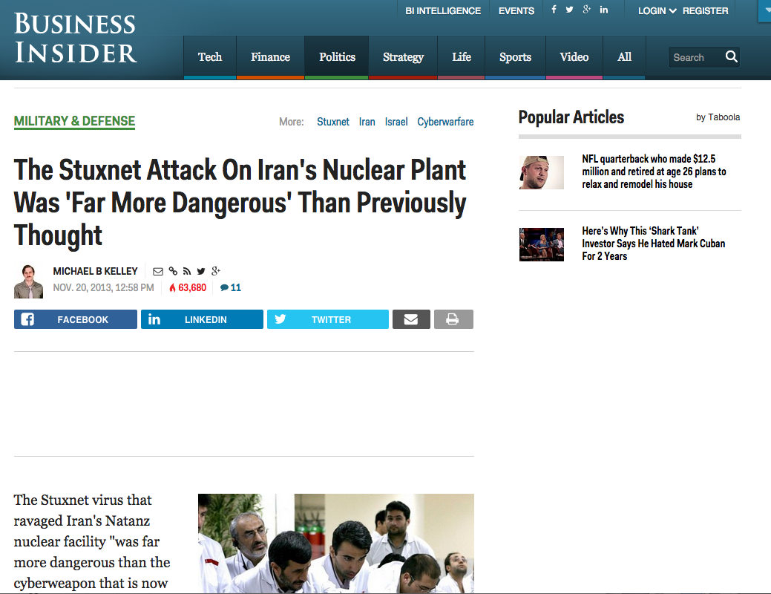

Slide 16
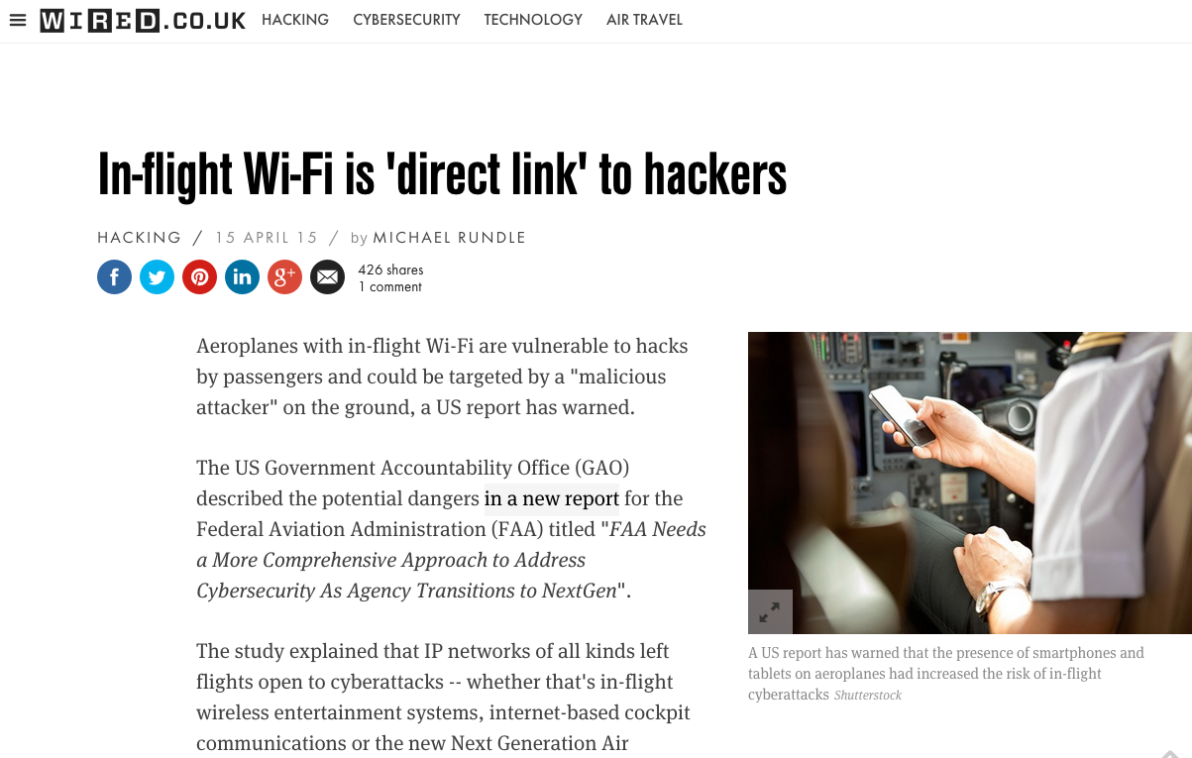

Slide 17
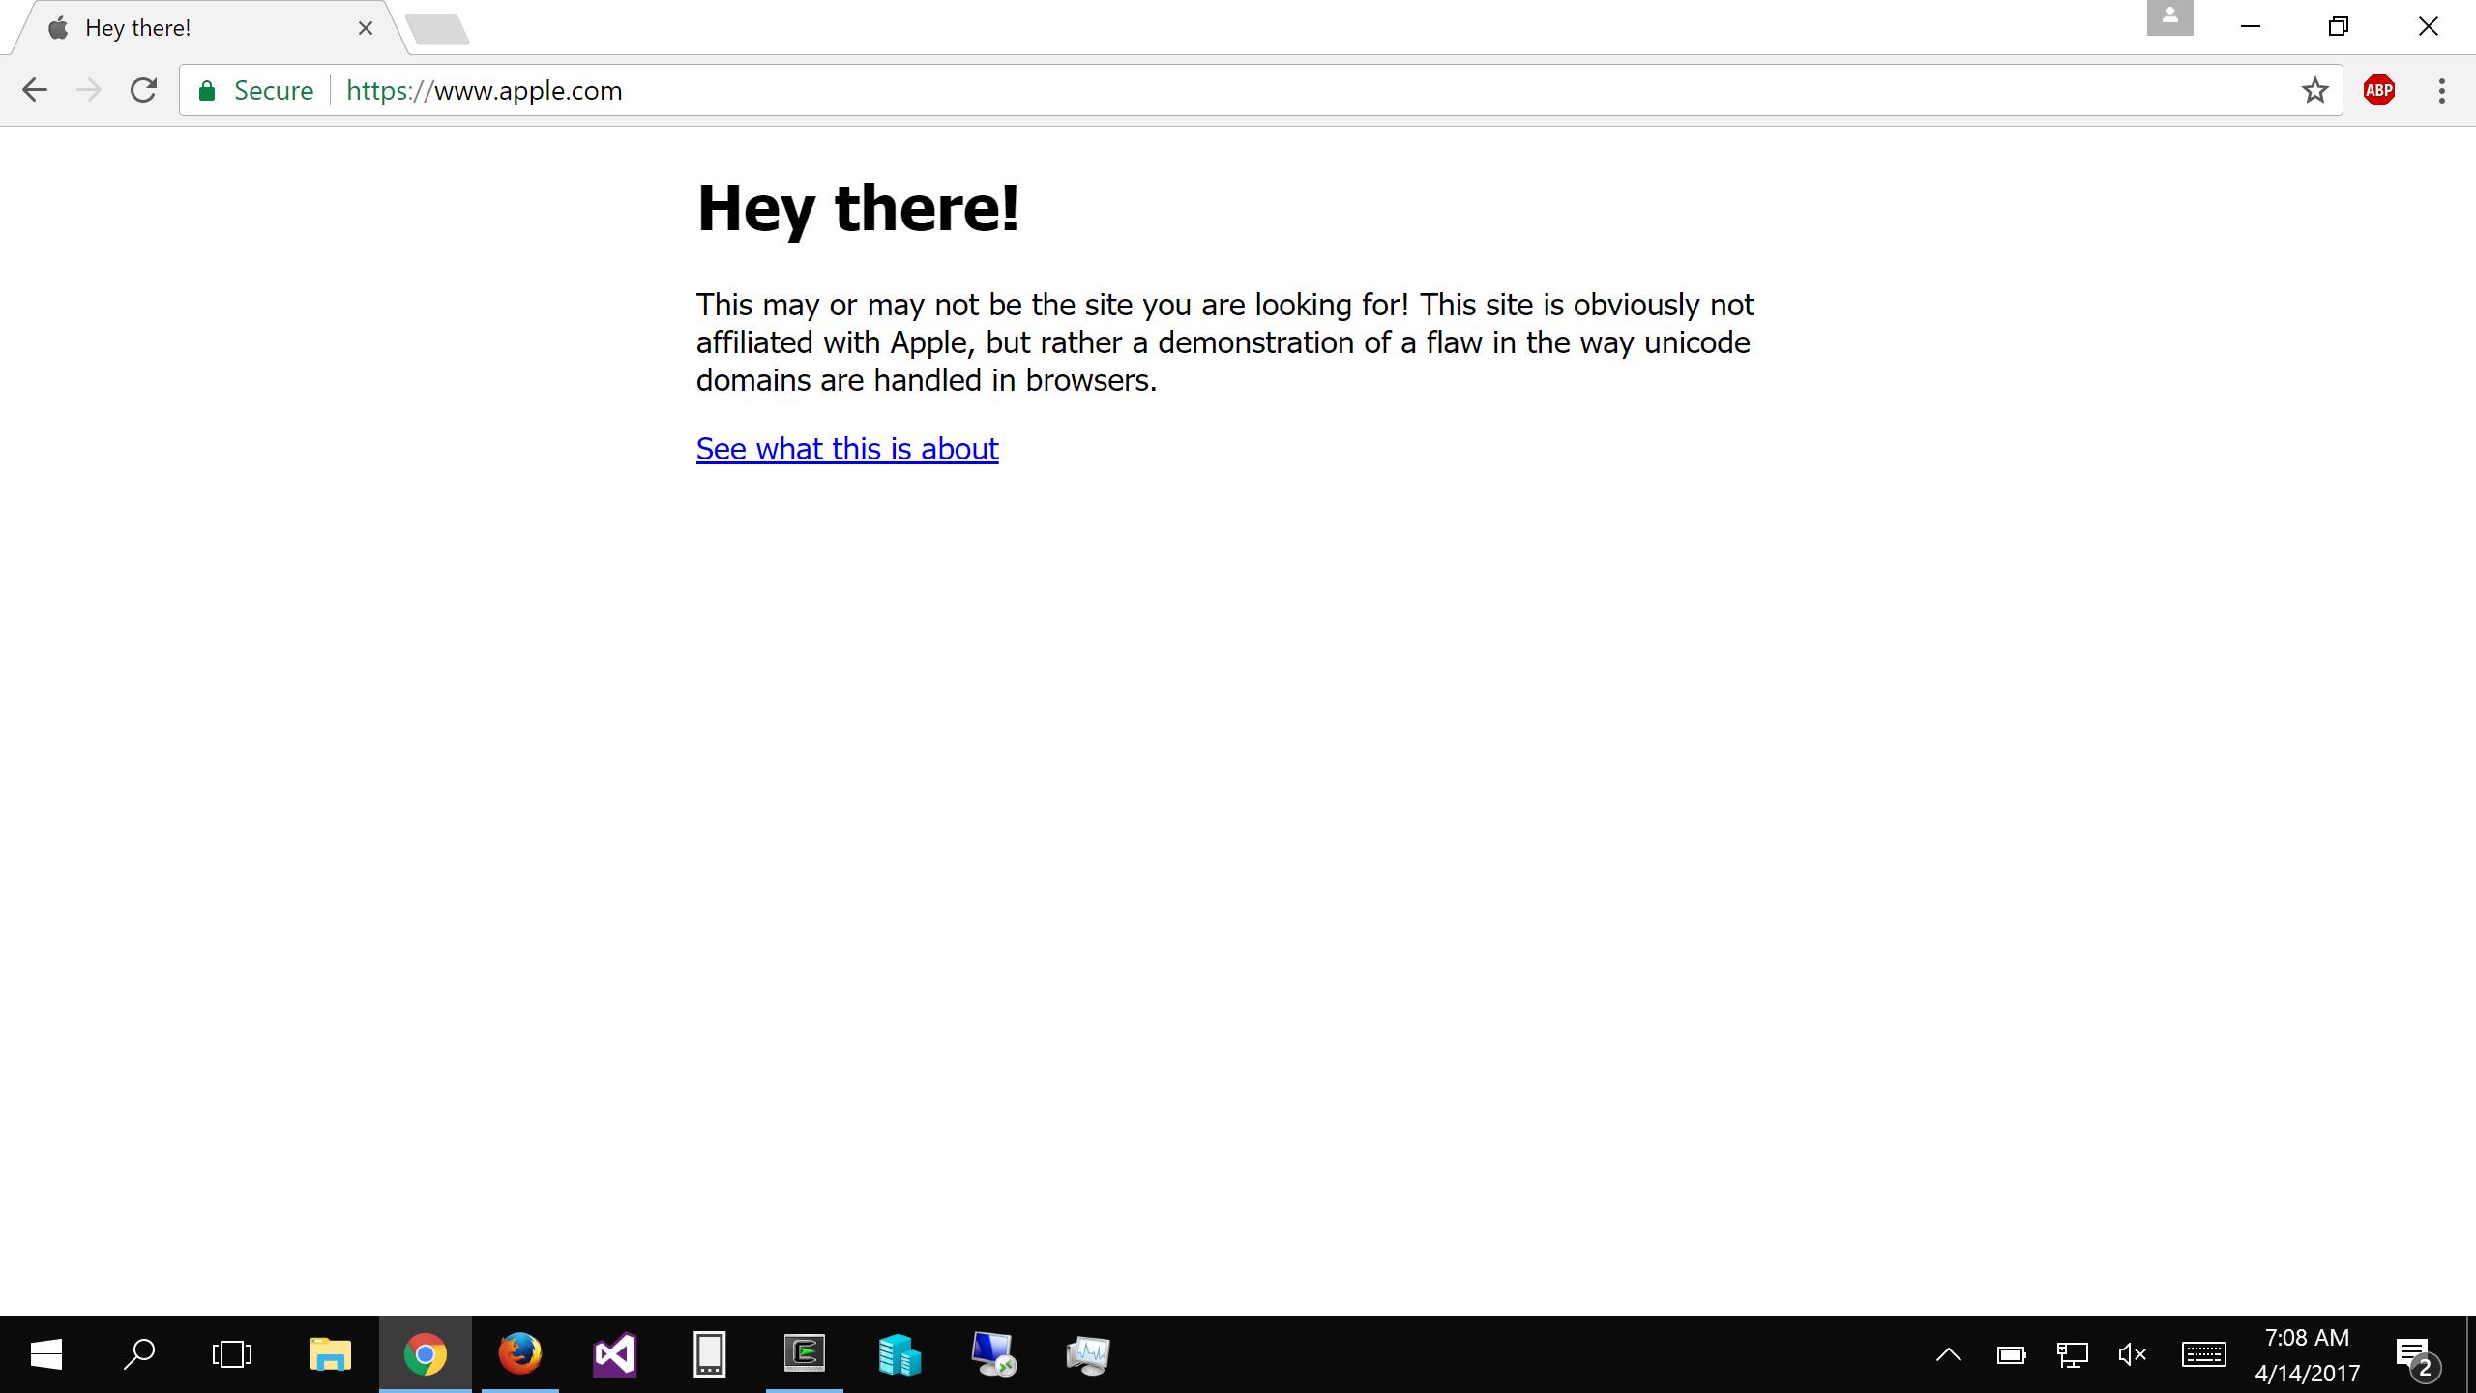
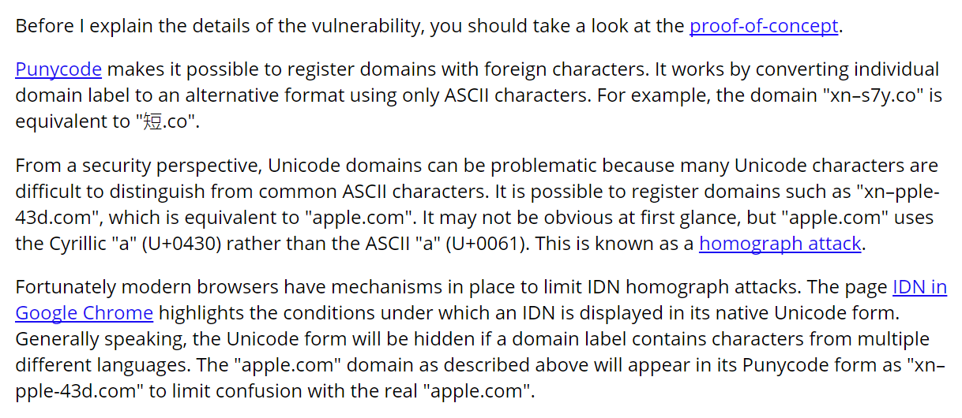

Slide 18
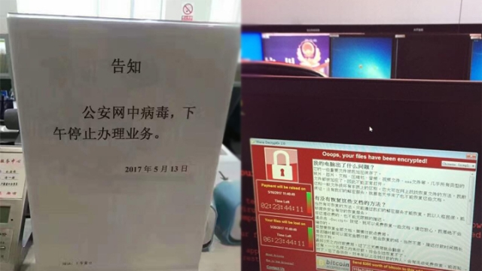

Slide 19
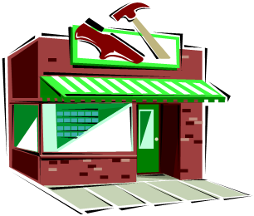


.
HOW TO SHOP FOR FREE ONLINE (S&P'11)
Chuck, pay in Amazon with this signed letter:
Amazon, I want to pay with this letter
Great, I will ship order#123!
Dear Amazon,
order#123 is $10, when it is paid, text me at 425-111-2222. [Jeff's signature]
Jeff,
I want to buy this DVD.
Dear Amazon,
order#123 is $10, when it is paid, text me at 425-111-2222. [Jeff's signature]
Jeff
Hi,
$10 has been paid for order#123.
[Amazon's signature]
Shopper Chuck
Amazon
Note: phone number is analogous to the URL that Amazon uses to notify the merchant

Slide 20
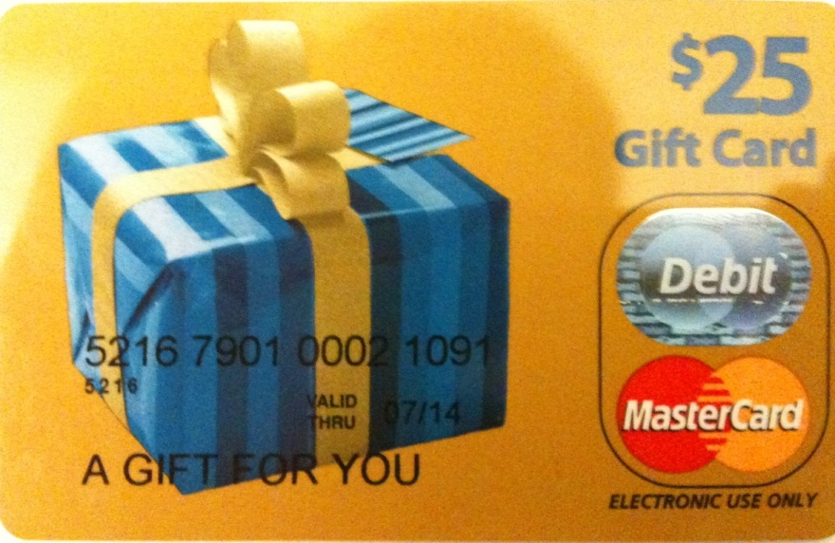



Flaw & exploit
Chuck, pay in Amazon with this signed letter:
Amazon, I want to pay with this letter
Dear Amazon,
order#123 is $10, when it is paid, text me at 425-111-2222.
[Jeff's signature]
Anyone can register an Amazon seller account, so can Chuck.
We purchased a $25 MasterCard gift card by cash
We registered it under the name "Mark Smith" with fake address/phone number
Registered for seller accounts in PayPal, Amazon and Google using the card
Great, I will ship order#123!
Jeff,
I want to buy this DVD.
Dear Amazon,
order#123 is $10, when it is paid, text me at 425-111-2222. [Jeff's signature] [Mark's signature]
Jeff
Hi,
$10 has been paid for order#123.
[Amazon's signature]
Shopper Chuck
(and seller Mark)
Chuck's trick
Pay to Mark (i.e., Chuck himself), but check out from Jeff
Amazon is tricked to tell Jeff a payment between Chuck and Mark
Jeff is confused by Amazon
Amazon
(CaaS)

Slide 21
Other Attacks
Buffer overflow attack (stack/heap)
ROP attack (Return-Oriented Programming)
Password attack
Phishing attack
XSS attack (Cross Site Script)
SQL injection attack
Integer overflow attack
Social engineering attack
Side-channel attack
…
上一页的”0元购”中的几个问题：1.购买匿名信用卡本身是不合法的，2.Amazon并没有检查一个text编号与对应的signature是否真正的绑定匹配。因而被用户修改之后仍然能够正常执行。

Slide 22
Security: Real World VS. Computer
Security in general not a particularly new concern
Banks, military, legal system, etc. have always worried about security
Similarities with computer security:
Want to compartmentalize (different keys for bike vs. safe deposit box)
Log and audit for compromises
Use legal system for deterrence

Slide 23
Security: Real World VS. Computer
Significant differences with computer security:
Internet makes attacks fast, cheap, and scalable
Huge number of adversaries: bored teenagers, criminals worldwide, etc.
Anonymous adversaries: no strong identity on the internet
Adversaries have lots of resources (compromised PCs in a botnet)
Attacks can often be automated: systems compromised faster than can react
Users often have poor intuition about computer security
E.g., misunderstand implications of important security decisions

Slide 24
Why is Security So Hard?
Security is a negative goal
Want to achieve something despite whatever adversary might do
A positive goal: "XYB can read exam.txt".
Ask XYB to check if our system meets this positive goal
A negative goal: "Ben cannot read exam.txt".
Ask John if he can read exam.txt?
Good to check, but not nearly enough..
Must reason about all possible ways in which John might get the data
How might Ben try to get the contents of exam.txt?
positive goal很容易验证，因为他是”用户知道自己能做什么”；
negative goal不容易验证，因为他是”用户不知道自己到底能不能做什么”；即用户需要通过所有可能的方式来验证是否能做，但是想要获取”所有的可能方式”是很难的。
Notes:
We've seen negative goals already: all-or-nothing atomicity w/ crashes.
With crashes, just had to think of where we might crash.
Much harder to consider all possible cases with an adversary.
Security is also often hard because system has many complex goals.

Slide 25
Ways to Access exam.txt
Change permissions on exam.txt to get access
Access disk blocks directly
Access exam.txt via ipads.se.sjtu.edu.cn
Reuse memory after XYB's text editor exits, read data
Read backup copy of exam.txt from XYB's text editor
Intercept network packets to file server storing exam.txt
Send XYB a trojaned text editor that emails out the file
Steal disk from file server storing exam.txt
Get discarded printout of exam.txt from the trash
Call sysadmin, pretend to be XYB, reset his password
… when should we stop thinking of more ways?

Slide 26
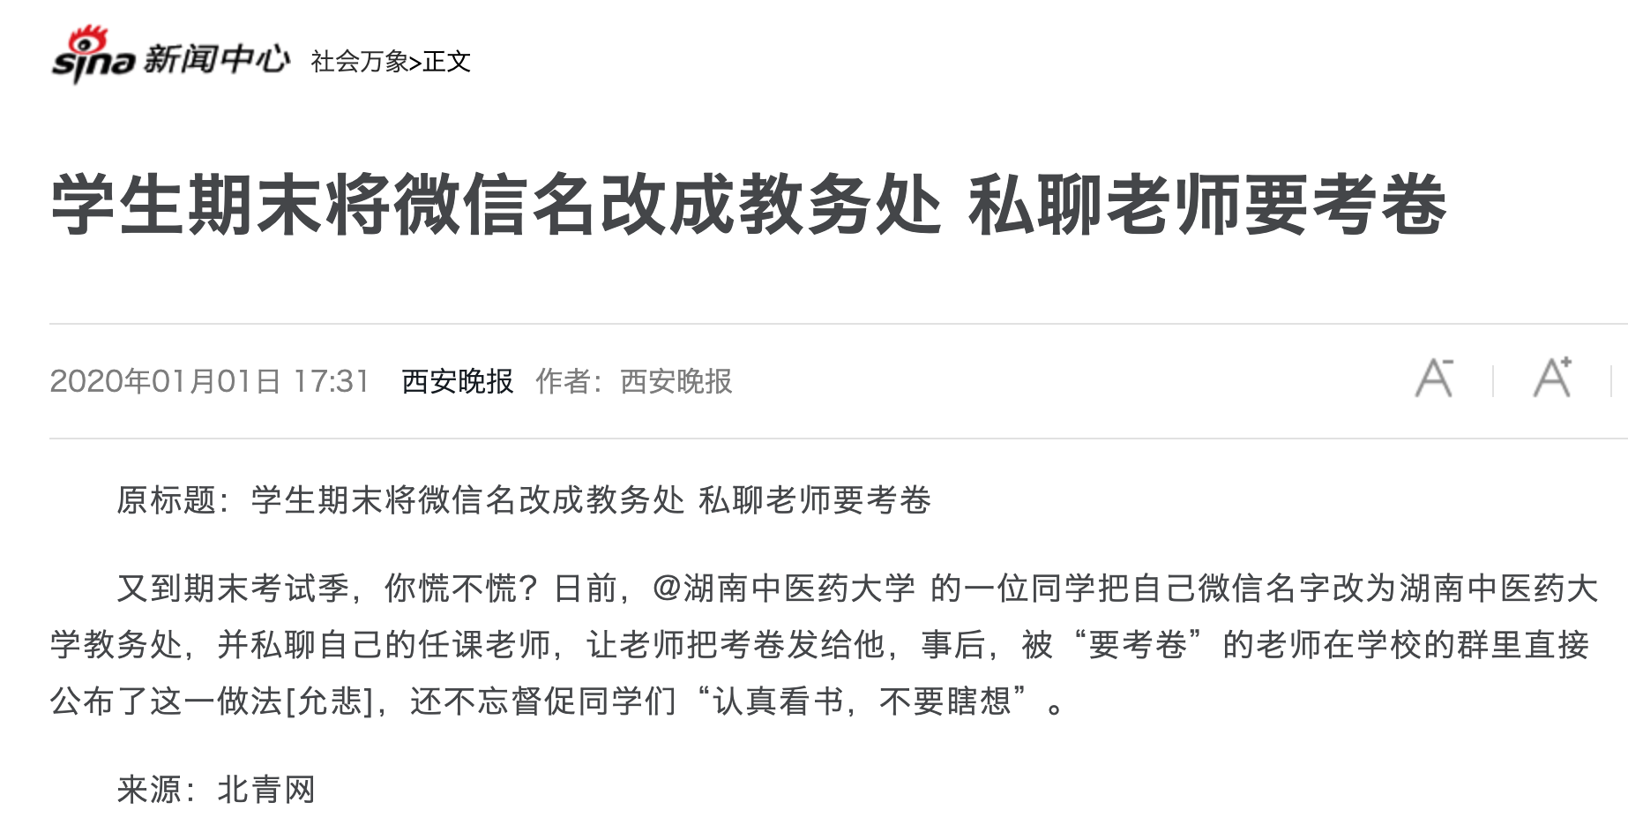

Slide 27
Why is Security So Hard?
Security sometimes conflicts with other goals
Security VS. performance
Security VS. availability(忘记密码会无法使用)
Security VS. fault tolerance(为了安全会要求备份数量减少)
Security VS. convenience(输入密码可能比较麻烦)
Security VS. simplicity
...

Slide 28
Fault Tolerant Fails Here
Why not using fault tolerant techniques for security?
Since security can be seen as a kind of fault
Two reasons
Result of "fault" may be too much (cannot afford once)
E.g., exam leakage, rocket launching
Failures due to attack might be highly correlated
In fault-tolerance, we assumed independent failures

Slide 29
Much Harder to Reason about Security
No complete solution; we can't always secure every system
One solution: Trust nothing that you didn't create by yourself
What are we going to learn?
How to model systems in the context of security
How we think about and assess risks
Techniques for assessing common risks
There are things we can do to make systems more secure
Know trade-offs
Security vs. performance, security vs. convenience, and security vs. simplicity

Slide 30
2 Steps towards Building a More Secure System
How to make progress in building a secure system?
Be clear about goals: "policy"(CIA)
Be clear about assumptions: "threat model"

Slide 31
Policy: Goals
Information security goals:
Confidentiality(保密性): limit who can read data
Integrity: limit who can write data
Liveness goals:
Availability: ensure service keeps operating(DOS会破坏这个属性)

Slide 32
Threat Model: Assumptions
Often don't know in advance who might attack, or what they might do
Adversaries may have different goals, techniques, resources, expertise
Cannot be secure against arbitrary adversaries
As we saw with Ben vs. XYB
Adversary might be your hardware vendor, software vendor, administrator, …
Need to make some plausible assumptions to make progress

Slide 33
Threat Model: Assumptions
What does a threat model look like?
Adversary(攻击者) controls some computers, networks (but not all)
Adversary controls some software on computers he doesn't fully control
Adversary knows some information, such as passwords or keys (but not all)
Adversary knows about bugs in your software?
Physical attacks?
Social engineering attacks?
Resources? (Can be hard to estimate either resources or requirements!)

Slide 34
Threat Model: Assumptions
Unrealistic / incomplete threat models
Adversary is outside of the company network / firewall
Adversary doesn't know legitimate users' passwords
Adversary won't figure out how the system works
Despite this, important to have a threat model
Can reason about assumptions, evolve threat model over time
When a problem occurs, can figure out what exactly went wrong and re-design
Overly-ambitious threat models not always a good thing
Not all threats are equally important
Stronger requirements can lead to more complexity
Complex systems can develop subtle security problems

Slide 35
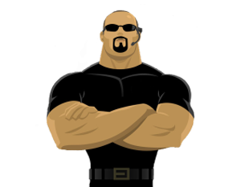
Guard Model

Slide 36
Guard Model of Security
Complete mediation
Only way to access the resource involves the guard
1. Must enforce client-server modularity
Adversary should not be able to access server's resources directly
E.g., assume OS enforces modularity, or run server on separate machine
2. Must ensure server properly invokes the guard in all the right places

Slide 37
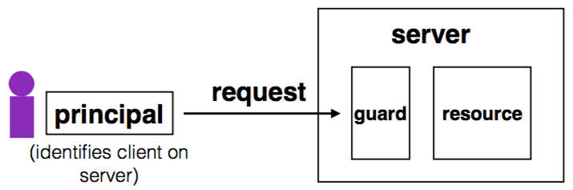
Complete Mediation
Guard typically provides:
Authentication: is the principal who they claim to be?
Authorization: does principal have access to perform request on resource?

Slide 38
Designing the Guard
Two functions often provided by a guard:
Authentication: request -> principal
E.g., client's username, verified using password
Authorization: (request, principal, resource) -> allow?
E.g., consult access control list (ACL) for resource
Simplifies security
Can consider the guards under threat model
But don't forget about complete mediation

Slide 39
Example: Unix FS
Resource: files, directories.
Server: OS kernel.
Client: process.
Requests: read, write system calls.
Mediation: U/K bit / system call implementation.
Principal: user ID.
Authentication: kernel keeps track of user ID for each process.
Authorization: permission bits & owner uid in each file's inode.

Slide 40
Example: Web Server
Resource: Wiki pages
Client: any computer that speaks HTTP
Server: web application, maybe written in Python
Requests: read/write wiki pages
Mediation: server stores data on local disk, accepts only HTTP reqs
Principal: username
Authentication: password
Authorization: list of usernames that can read/write each wiki page
Notes:
Note: requires setting file permissions, etc; assumes OS kernel provides complete mediation.

Slide 41
Example: Firewall
Resource: internal servers
Client: any computer sending packets
Server: the entire internal network
Requests: packets
Mediation:
internal network must not be connected to internet in other ways
no open wifi access points on internal network for adversary to use
no internal computers that might be under control of adversary
Principal, authentication: none
Authorization: check for IP address & port in table of allowed connections

Slide 42
What Can Go Wrong?
1. Bypass complete mediation by software bugs
2. Bypass complete mediation by an adversary
3. Policy vs. mechanism
4. Interactions between layers, components
5. Users make mistakes
6. Cost of security

Slide 43
Bypassing Complete Mediation
All ways to access resource must be checked by guard
Common estimate: one bug per 1,000 lines of code
Adversary may trick server code to do something unintended, bypass guard
How to prevent bypassing?
Reduce complexity: reduce lines of code
The "principle of least privilege"

Slide 44
Example: Paymaxx.com (2005)
https://my.paymaxx.com/
Requires username and password
If you authenticate, provides menu of options
One option is to get a PDF of the tax form
https://my.paymaxx.com/get-w2.cgi?id=1234
Gets a PDF of W2 tax form for ID 1234
get-w2.cgi forgot to check authorization
Attacker manually constructs URLs to fetch all data

Slide 45
Example: SQL Injection
username | email | public?
matei | matei@sjtu.edu.cn | yes
mike | mcarbin@sjtu.edu.cn | yes
katrina | lacurts@sjtu.edu.cn | no
SELECT username, email FROM users WHERE
username='<username>' AND public='yes'
Let <username> = katrina' OR username='
SELECT username, email FROM users WHERE
username='katrina' OR username='' AND
public='yes'

Slide 46
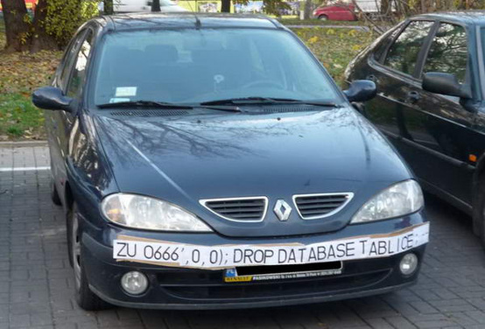
SQL Injection
ZU 0666',0,0);; DROP DATABASE TABLICE;

